Slide 1
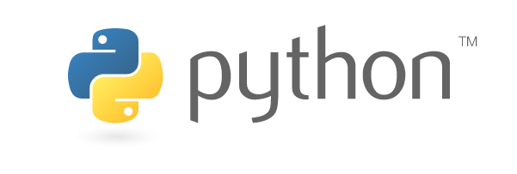
VARIABLE DECLARATION

Slide 2
SESSION OVERVIEW:
VARIABLE DECLARATION
INDENTATION
STATEMENTS & COMMENTS
VARIABLES
DATA TYPES
INPUT & OUTPUT
OPERATORS

Slide 3
VARIABLE DECLARATION
Variables must be Declared before they are used in other Languages.
In Python, there is no Explicit Variable Declarations
Variables have to be Assigned before they are Accessed.
Once a Variable is Assigned , you can Access it by using it’s Name.

Slide 4
INDENTATION
Most of the Programming Languages like C , C++ , Java use Braces { } , to Define a Block of Code.
Python uses Indentation.
Indentation are Generally 4 White Spaces ( Tabs )
Incorrect Indentation will lead to IndentationError.

Slide 5
STATEMENTS & COMMENTS
Instruction that a Python Interpreter can Execute are called Statements.
Statements which are Ignored by the Python Interpreter are called Comments
Single Line Comments : Hash (#)
Multi Line Comments : Triple Quotes (‘’’) or (“””)

Slide 6
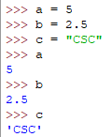
VARIABLES
A variable is a Location in Memory used to store Some Data (Values)
We Use the Assignment Operator (=) to assign the value to the variable
Any Datatype of value can be assigned to any Valid Variable
Eg : a = 5
Here , a –> variable which stores the value (5)

Slide 7
DATA TYPES
Numbers
Strings
List
Tuples
Set
Dictionary
Numbers :
Int
Long
Float
Complex

Slide 8

INPUT
It is used To get the Value from the User.
Like scanf() in C, cin>> in C++.
In Python we use input() Function
Syntax :
<Variable> = input(<prompt>)

Slide 9


OUTPUT
It is used To display the Value on the output screen.
Like printf() in C, cout<< in C++.
In Python we use print() Function
Syntax :
print(<variable>)

Slide 10
OPERATORS
Arithmetic operators
Bitwise operators
Comparison operators
Logical operators
Identity operators
Membership operators
Assignment operators

Slide 11
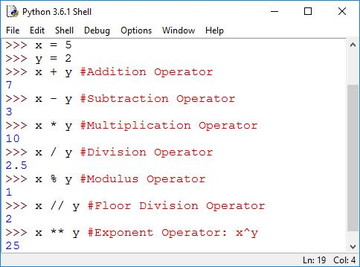
ARITHMETIC OPERATOR :

Slide 12
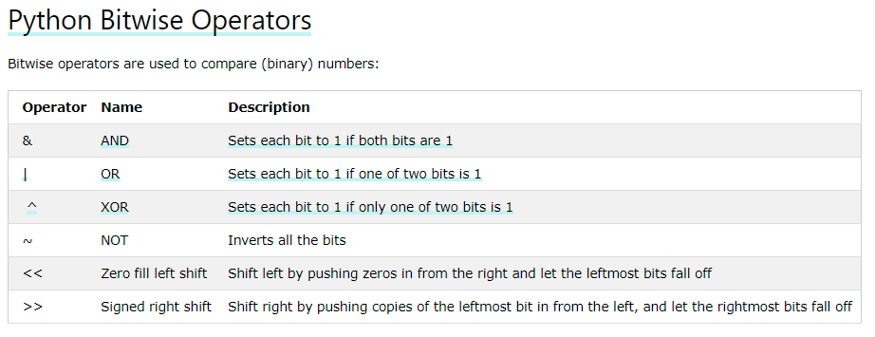

Slide 13
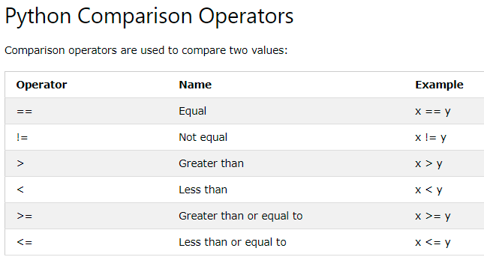

Slide 14
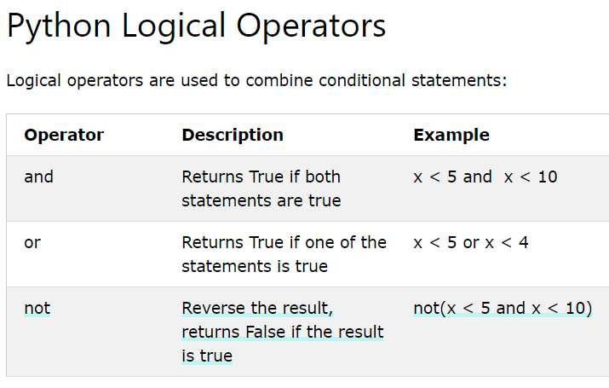

Slide 15
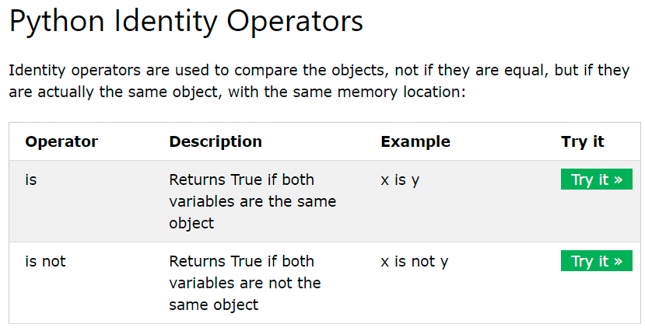

Slide 16
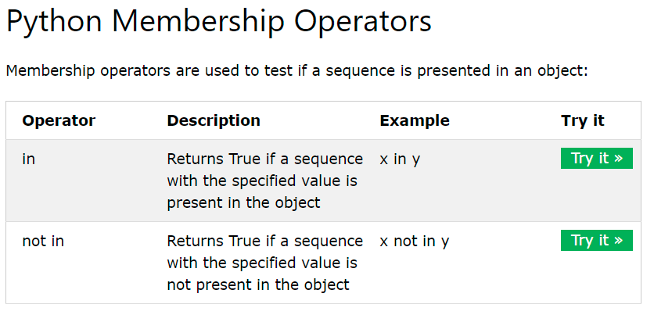

Slide 17
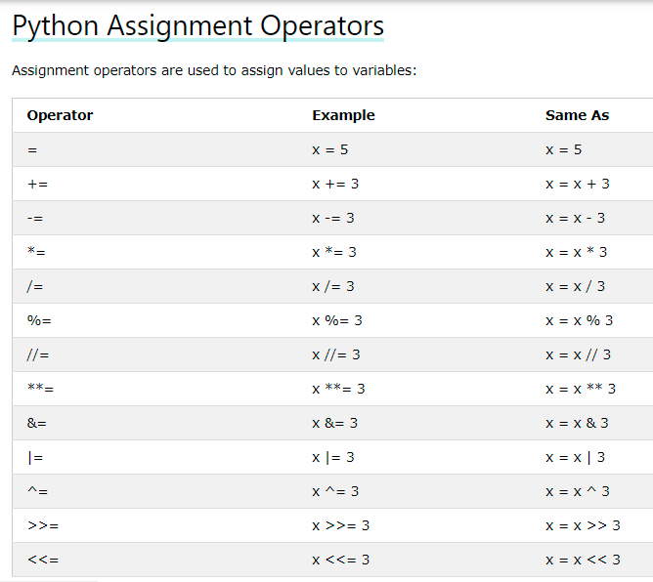
Short Hand Operators

Slide 18
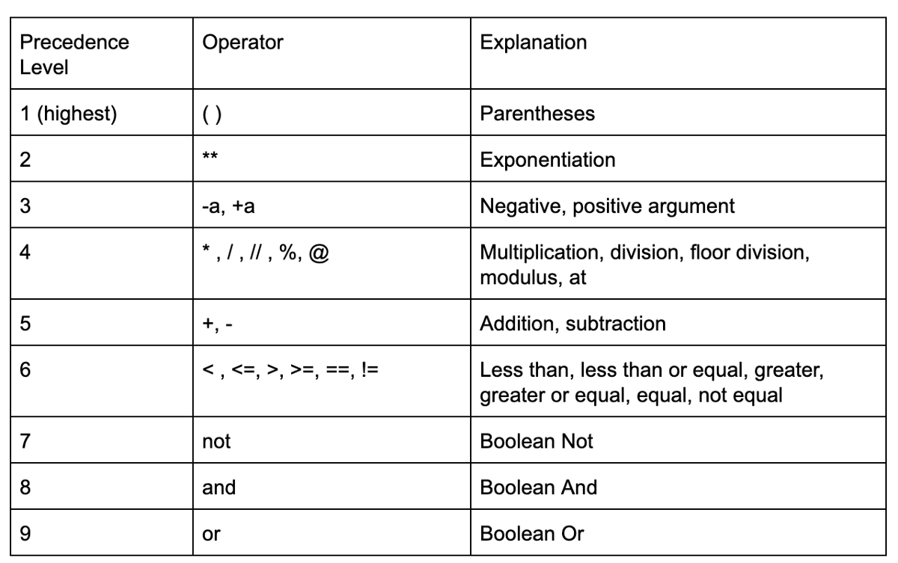

Slide 19

CODING IS FUN ! THANK YOU !!

